Slide 1
Data Analytics and Predictions
Project
Prediction of Mortality in SAH patients
Jaehwan Han
Seokhun Kim
Babak Soltanalizadeh

Slide 2
Data Pre-processing
Encounter
data table
Medications
data table
Group by (encounter_id): frequency of each medication
One-hot-coding & multiplication with frequency
Group by: collapse so that 1 observation for each encounter_id
Procedures
data table
Group by (encounter_id): frequency of each procedure
One-hot-coding & multiplication with frequency
Group by: collapse so that 1 observation for each encounter_id
Merge with key(encounter_id)
Labs
data table
Group by (encounter_id): mean, max, min of each lab
One-hot-coding & multiplication with mean, max, min, respectively
Group by: collapse so that 1 observation for each encounter_id
After merging, the # of observations was 1370
Due to multicollinearity, max and min columns were dropped; only mean columns were kept

Slide 3
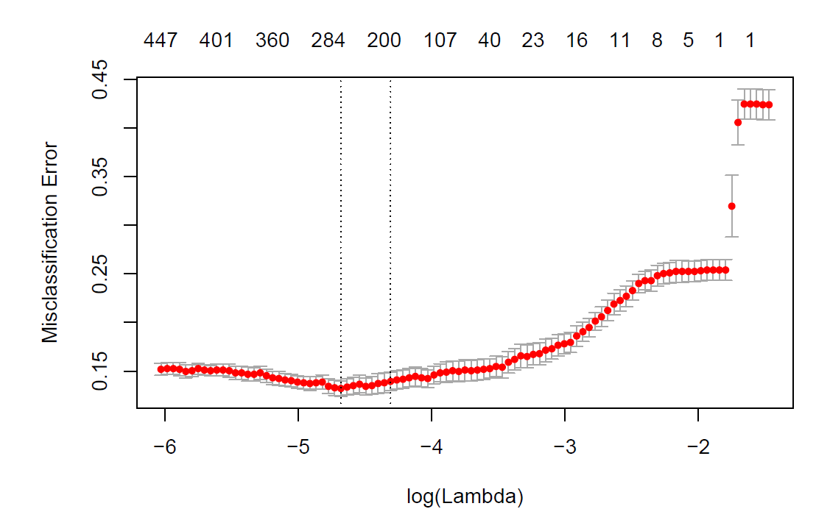
Lasso for Variable Selection
# of parameters = 2,284 >> # of observations = 1,370
- Potential problems: no unique parameter estimates, under-identified model, and poor prediction
- Lasso to select important variables that do not shrink to 0 at the optimal shrinkage parameter lambda
10-fold cross validation with different lambdas
- The optimal lambda = 0.0093
- The CV error rate = 13.21%
- 255 variables did not shrink to 0; selected as the predictor subset
*Additionally, 2nd Lasso for further variable selection;
Only 1 variable reduction; Thus, stick to the first Lasso subset

Slide 4
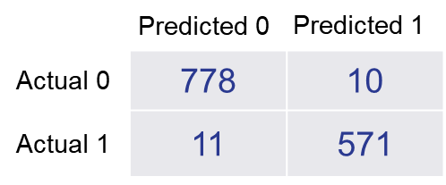
1. Logistic Regression
As the first step, logistic regression with 255 predictors
- Training error rate = 1.53%
- Confusion matrix
- 10-fold cross validation error rate = 12.96%
Indicating that
Linear classification boundary already works quite well
Possibility of overfitting due to many # of parameters (255) compared to # of observations (1370)

Slide 5
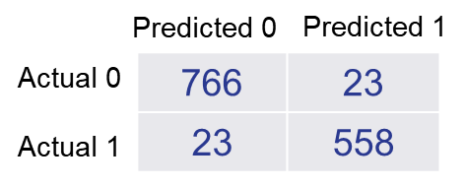
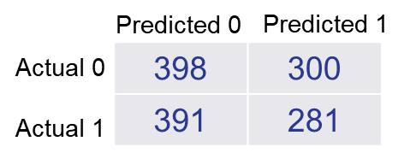
2. Linear Discriminant Analysis
Since linear boundary appears to work well, LDA to check if the boundary is rather separable
- Training error rate = 3.36%
- Confusion matrix
Poor CV error, possibly due to
multi-collinearity of predictors,
violation of equal variance-covariance matrix
between the 2 classes
(3) not-so-clear-separation between the 2 classes
- LOOCV error rate = 49.20%
- Confusion matrix
Indicating that
The 2 classes may not be separable
The distributions of predictors may be far from normality

Slide 6
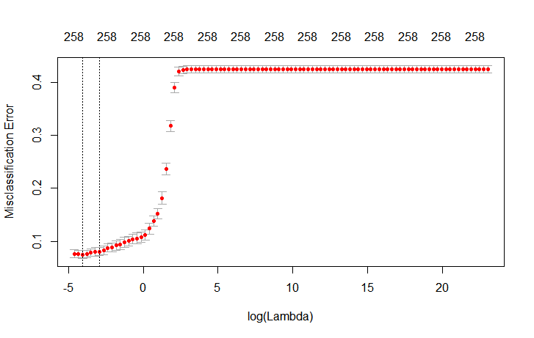
3. Ridge Logistic Regression
Due to potential overfitting of the Logistic regression model (255 parameters),
Ridge logistic model to reduce the variance by giving a slightly higher bias
10-fold cross validation with different lambdas
- The optimal lambda = 0.0175
- The CV error rate = 7.52% < logistic CV error rate 12.96%
- The training error rate = 2.55% > logistic training error rate 1.53%
- Showing that the Ridge model has a slightly higher biased but a quite lower variance, due to shrinkage

Slide 7
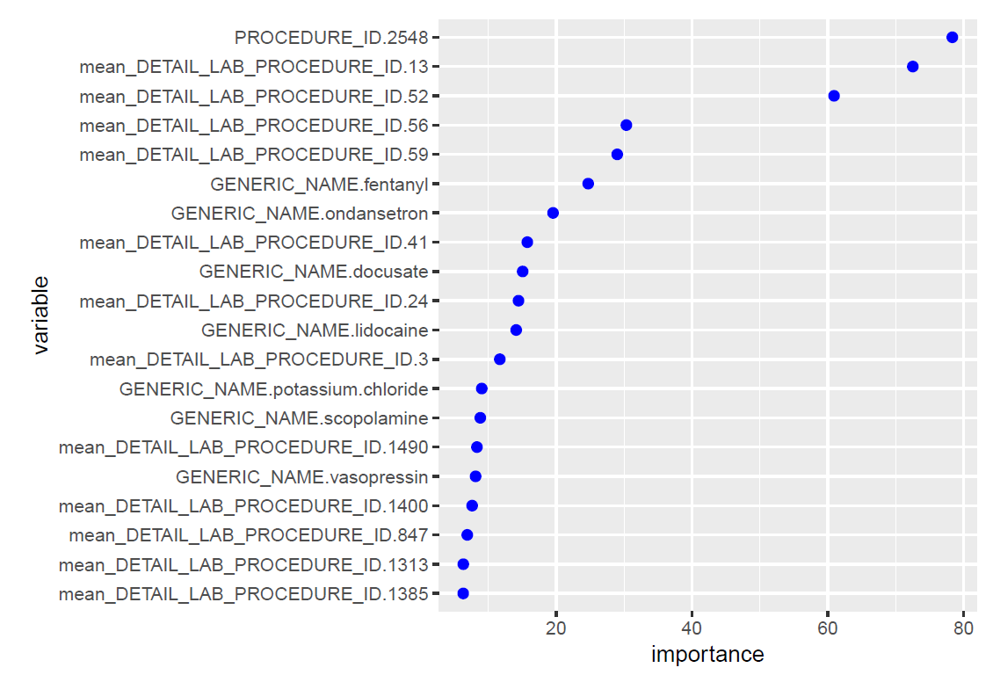
4. Random Forest
Although the linear models worked quite well,
also nonparametric tree-based models to check if they provide a better prediction performance
*No trial of single tree with pruning or bagging due to potential overfitting
Random forests with different mtry (subset size) and ntree (bootstrapped tree number)
- The best CV error rate for OOB = 12.63%
- mtry = 90 and ntree = 500
- The training error rate = 0%
Indicating that
The model was in fact overfitted
The CV error was still good, owing to the random forest’s averaging method across many trees,
which gave rise to a lower variance

Slide 8
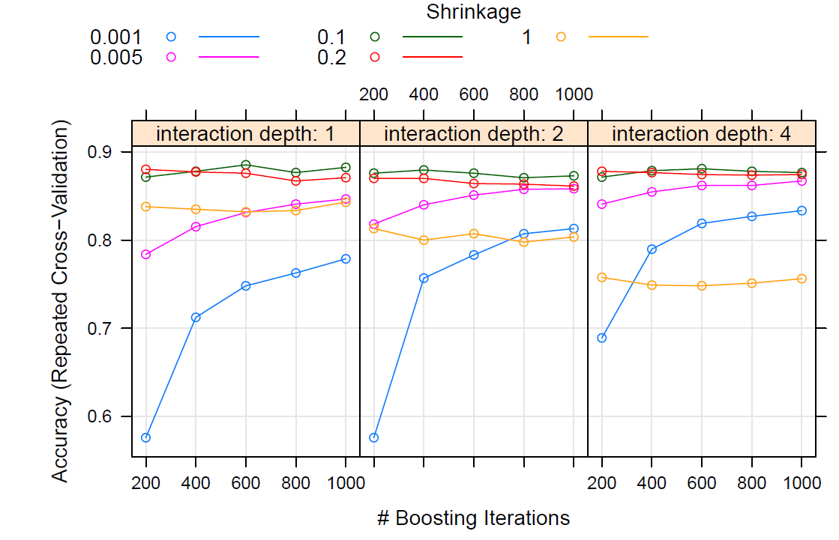
5. Gradient Boosting
Slow learning method, with different shrinkage, interaction depth, and ntree
- The best 10-fold CV error rate = 11.46%
- Shrinkage = 0.1, interaction depth = 1, and ntree = 600
- The training error rate = 6.5%
Indicating that
No or litter overfitting, and better CV error than Random forest
Not much better than logistic (CV error = 12.96%), and quite worse than Ridge logistic (CV error = 7.52%)
Supporting the idea that the true classification boundary is close to linearity

Slide 9
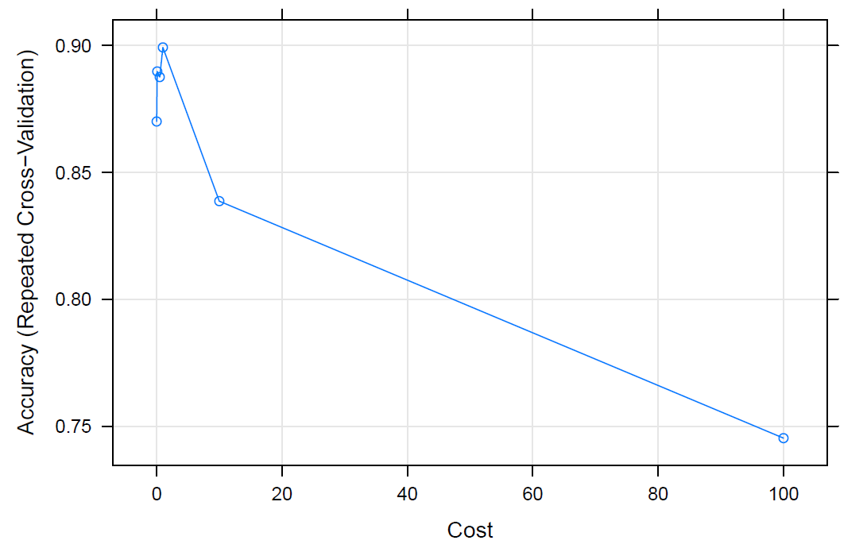
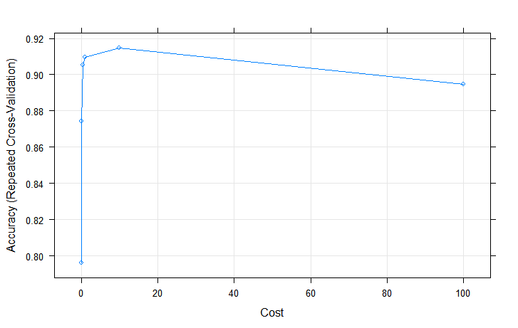
6. Support Vector Classifier (Linear)
A linear support vector classifier, with different costs
- The best 10-fold CV error rate = 10.81% (without scaling)
- Cost = 0.1; # of support vectors = 277 out of 1370
- The training error rate = 2.04%
- The best 10-fold CV error rate = 9.20% (after scaling; not in the report)
- Cost = 10; # of support vectors = 229 out of 1370
- The training error rate = 1.02%
Indicating that
With scaling, the cost is rather high, and the training error is
even smaller than logistic, but the CV error is also better than logistic
(2) However, still worse than Ridge logistic (CV error = 7.52%)

Slide 10
7. Support Vector Machine (Radial)
A radial support vector machine, with different costs and gammas
- The best 10-fold CV error rate = 40.36% (without scaling), cost = 10 and gamma = 0.01
- The training error rate = 0.07%; overfitting with its inherent nonlinearity
8. Neural Network
With different number of hidden units in 1 or 2 layers (after scaling; not in the report)
Hidden unit 0 (no hidden layer), 1 Hidden layer with 1 – 10 units; CV errors:
0.0993878 0.1156866 0.1116343 0.1137832 0.1118392 0.1143055 0.1109419 0.1127993 0.1085745 0.1193699 0.1095874
2 Hidden layers with hidden units 10 & 1 – 10; CV errors:
0.1121527 0.1104723 0.1056644 0.1143054 0.1117427 0.1131508 0.1049973 0.1118163 0.1084483 0.1026214
- The best 10-fold CV error rate = 9.94% (with 0 hidden unit)
- The training error rate = 0.88% (with 0 hidden unit)
Indicating that
Slightly more overfit than SVC (training = 1.02%), and thus slightly lower CV error than SVC (CV error = 9.20%)
0 hidden unit is the best, supporting again that the true boundary is close to linearity

Slide 11
Conclusion
The results presented that a Ridge logistic regression model produced the best CV mis-classification error rate
CV error rate is a reliable estimator of test error; the Ridge logistic regression model will be the best model with the highest predictive-ability
(1) The better performance of linear models, especially with shrinkage (Ridge is the best) and or soft margin (linear SVC is the next), and (2) that the flexible non-parametric methods (random forest and boosting) produced only slightly better results than the non-shrunken linear model (logistic), indicate that the true classification boundary for mortality is quite close to linearity
In the future, we may apply a new method, if any, for further variable selection because the current 255 variables are still a lot, and therefore, undermine the interpretability of models.

